Slide 1

Diffraction Grating &
Resolving Power
MD. GULAM MUSTAFA
Lecturer (Physics)
Department of Science & Humanities
Bangladesh Army International University of Science and Technology (BAIUST)
Syedpur, Cumilla-3501

Slide 2

Whatever we will discuss
Diffraction grating and its types
Theory of transmission grating
Determination of wavelength using grating
Related Mathematical Problems
Resolving Power

Slide 3



Diffraction Grating
The special device for the production of diffraction is called grating. It consists of a very large number of narrow slits of equal width side by side. Grating is primarily of two types; viz-
1) Transmission grating and
2) Reflection grating
A plane transmission grating is a transparent plate or surface made of glass or of similar material on which a very large number of equidistant parallel lines very near to each other are scratched by a sharp diamond point. Here each line acts as an opaque line and the space between two lines acts as thin slit. Each centimeter of this grating contains 5000 to 6000 lines.
If the lines are drawn on a silvered surface (plane or concave) then light is reflected from the positions of the mirror in between any two lines and such surfaces act as reflection gratings.
The distance from the starting of a slit to the starting of the next slit is called the grating constant. It can be said in other words that from the terminal end of a slit to the terminal end of the next slit is called the grating constant.

Slide 4
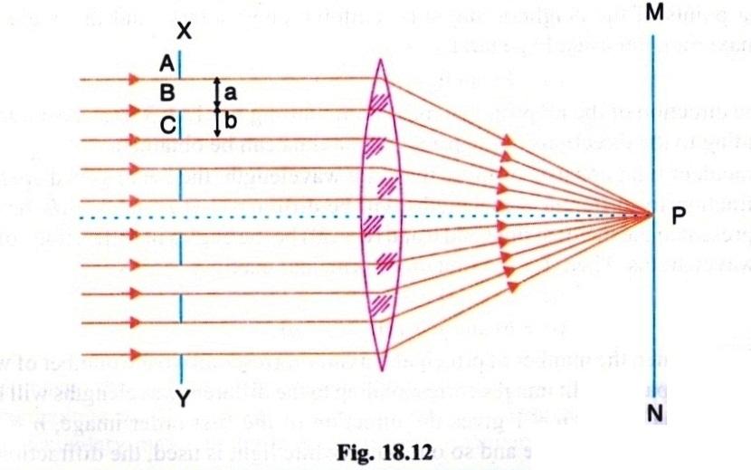
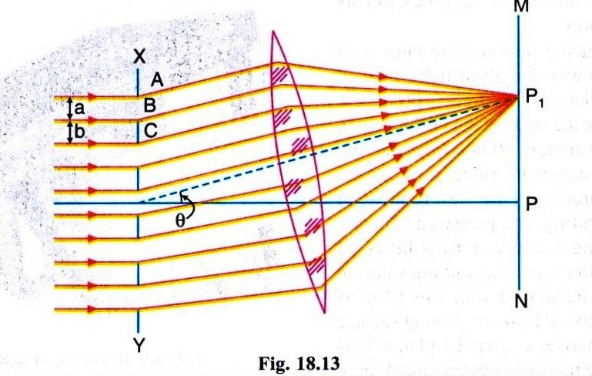
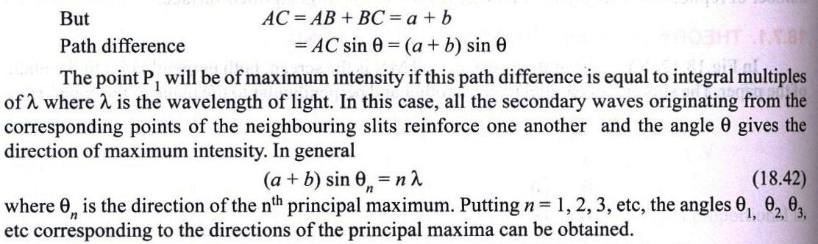
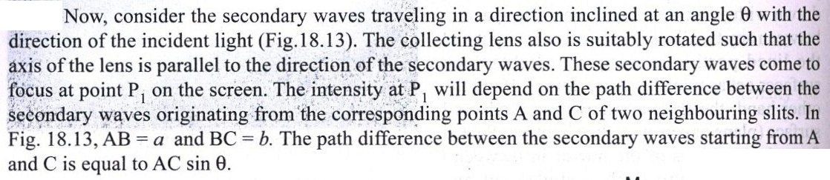
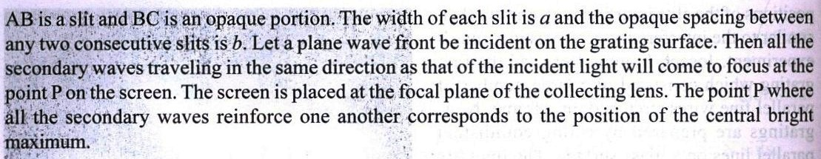
Theory of Transmission Grating

Slide 5
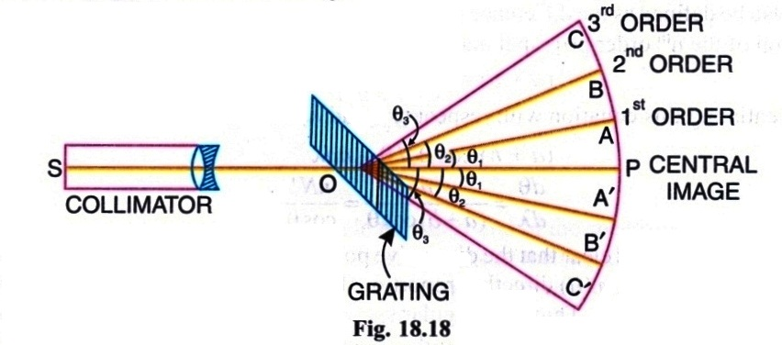
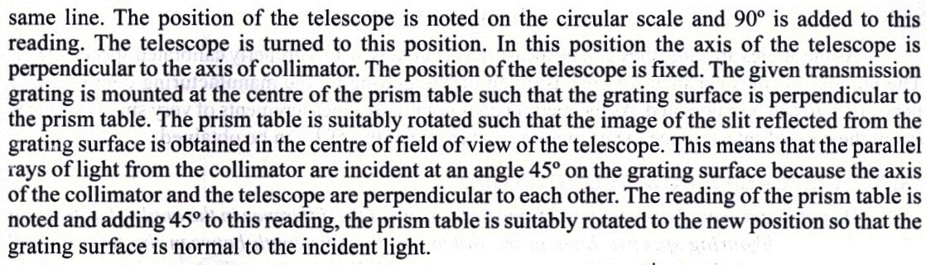
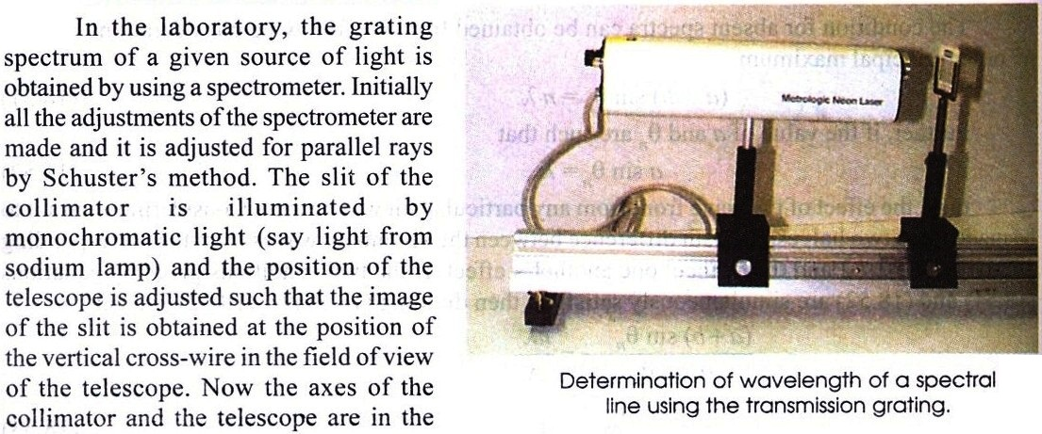
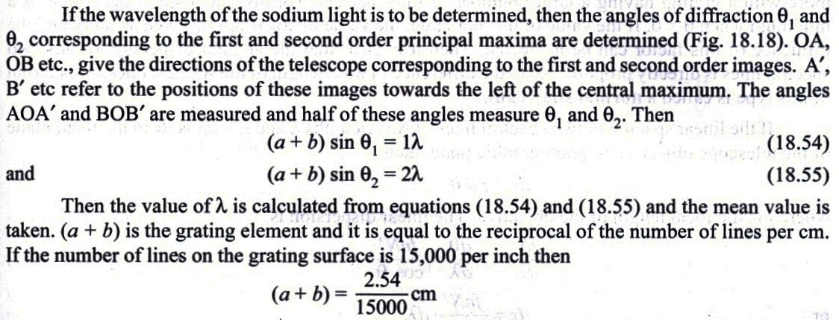
Wavelength determination by Grating

Slide 6
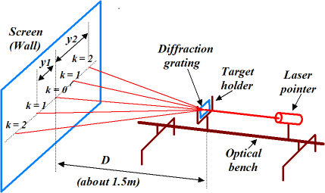
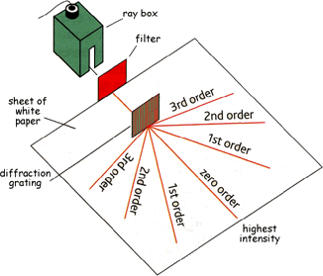
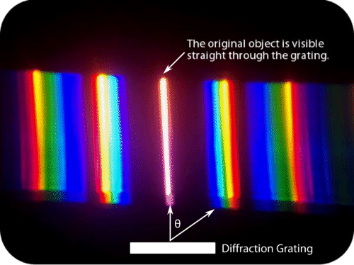
Diffraction Grating

Slide 7
Related Mathematical Problems
  A parallel beam of monochromatic light is allowed to be incident normally on a plane grating having 1250 lines per cm and a second order spectral line is observed to be deviated through 30⁰. Calculate the wavelength of the spectral line. [Old edition - 492 page (Exam-9.22), New edition - 461 page (similar to Ex.-9)] Ans. 2 x 10⁻⁴ cm
  What is the highest order spectrum, which may be seen with monochromatic light of wavelength 6000 A⁰ by means of a diffraction grating with 5000 lines/cm. [Old edition - 492 page (Exam-9.23), New edition – 461 page (similar to Ex.-6)] Ans. 3
  A parallel beam of monochromatic light is allowed to be incident normally on a plane transmission grating having 5000 lines/cm and the second order spectral line is found to be diffracted through 30⁰. Calculate the wavelength of light. [Old edition - 496 page (Exam-9.30), New edition – 461 page (similar to Ex.-9)] Ans. 5000A⁰

Slide 8
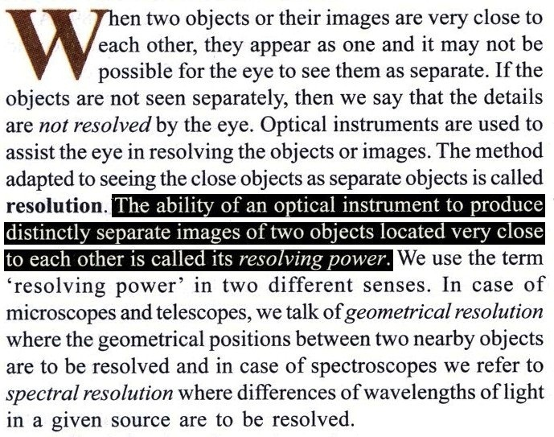
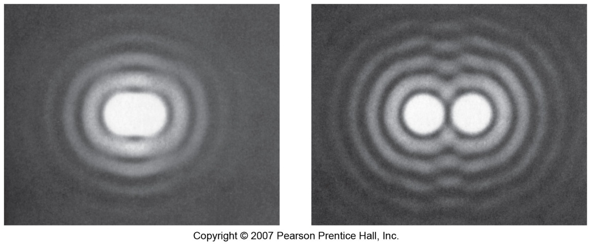
Resolving Power
Sources are not resolved and appears as single source;
Two sources are clearly resolved.

Slide 9


